Slide 1
Connections of bones
Reinitz László Z.

Slide 2
Arthrologia generales- general arthrology
Classification based on the freedom of movement
Synarthrosis [Articulationes fibrosae]
limited movement, connection through connective tissue
Amphiarthrosis
limited movement
narrow articular gap
may be through cartilage or ligaments
art. carpometacarpea
Diarthrosis – [Articulationes synoviales]
unlimited movement
(Synsarcosis)
connection via muscles

Slide 3
Synarthrosis [Articulationes fibrosae]
No joint gap
Synostosis - ossification
Ru McIII-IV.
Gomphosis – penetration
alveolus-tooth
Suturae - suture
Sutura serrata – saw suture
Ossa parietalia
Sutura foliata – leaf suture
Sutura frontonasalis
Sutura squamosa –squamosal suture
Sutura squamosofrontalis
Sutura plana – flat suture
Sutura internasalis
Syndesmosis – through connective tissue, ligament
Car: radius-ulna

Slide 4
Amphiarthrosis [Articulationes cartilagineae]
minimal joint gap
able to move in every directions
but those are very limited
Art. carpometacarpea
Synchondrosis
hyalin cartilage
Art. sternocostalis
Symphysis
fibrous cartilage
Symphysis pelvis

Slide 5
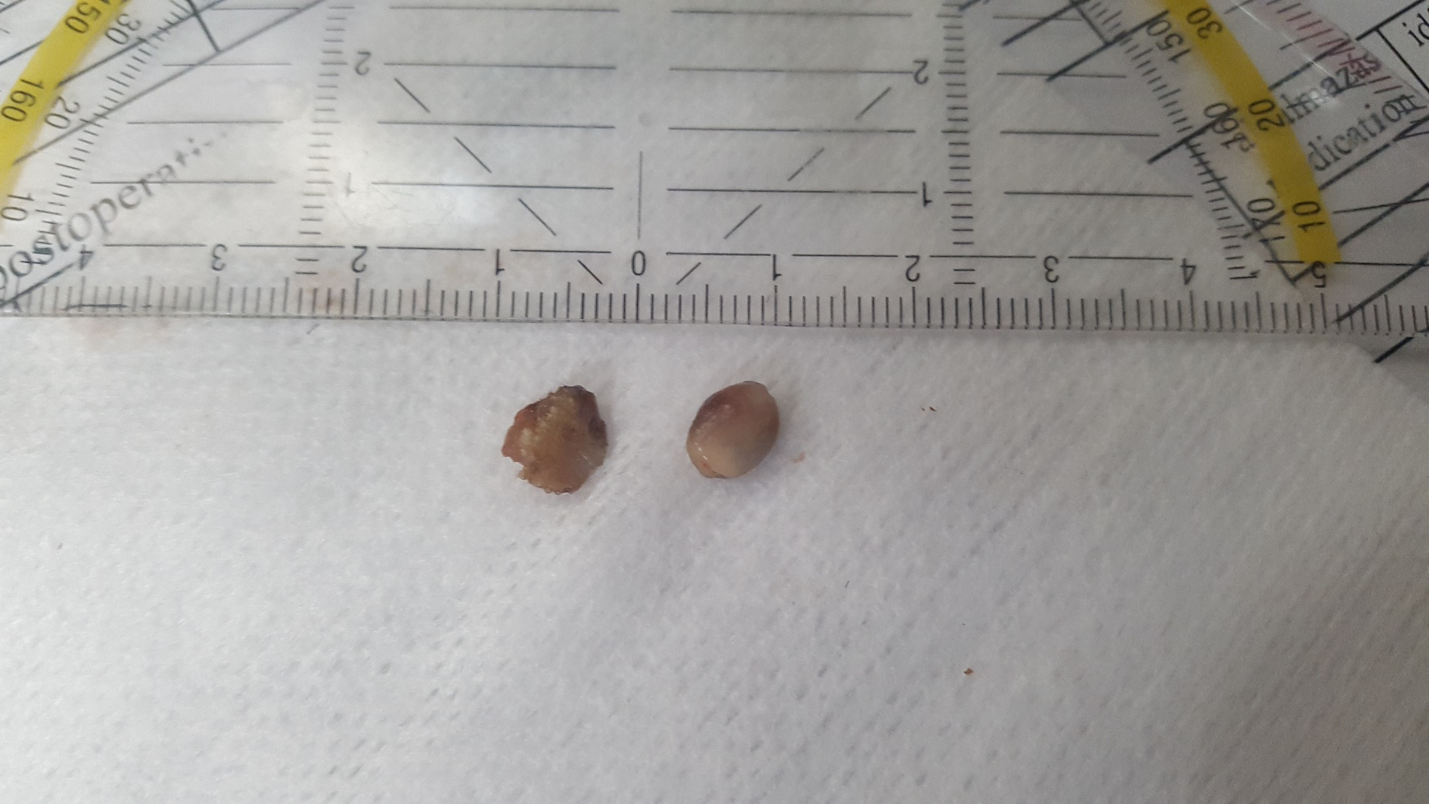
Diarthrosis [Articulationes synovialis]
Joint gap
Free movement
General description of joints [drawing]
[video]
Ligaments of joints
Ligg. Intercapsularia
Ligg. Extracapsularia
Ligaments within the joint cavity
If the surfaces do not match (incongruent surfaces)
Cartilage supplement
discus – separates the joint into 2 independent parts
meniscus – does not separate it fully
labrum – to increase the surface
© Dr. Lehner László

Slide 6
Diarthrosis [Articulationes synovialis]
Flexion-extension [flexio-extensio]
Overextension [hyperextensio]
Abduction-adduction [abductio-adductio]
Turning inside/outside [pronatio-supinatio]
Rotation [rotatio]

Slide 7
Diarthrosis [Articulationes synovialis]
Classification based on the number of participating bones
Articulatio simplex (two bones)
eg.: hip joint
Articulatio composita (three or more bones)
eg.: elbow joint
Articulatio duplex (discus/meniscus between the bones)
eg.: art. femorotibialis

Slide 8
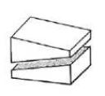
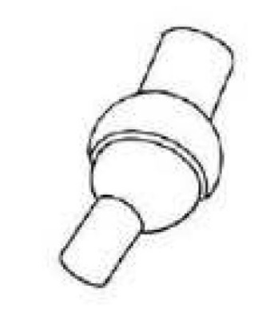
Diarthrosis [Articulationes synovialis]
(Classification based on function)
Classification based on the number of axis
Single axial
Biaxial
Multiaxial
Classification based on the form of the joint surfaces
Art. plana – sliding joint
Flat surfaces lying, sliding on top of each other
Processus articularis cran.⬄ Processus articularis caud.
Art. sphaeroidea – spherical joint
Multiaxial
Nearby muscles may limit the freedom of movement
Shoulder joint, hip joint

Slide 9
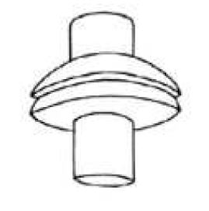
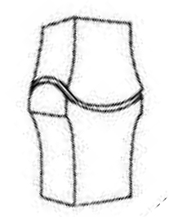
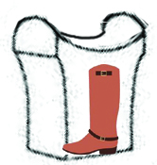
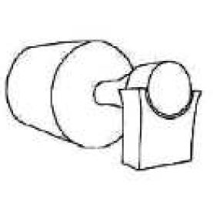
Diarthrosis [Articulationes synovialis]
Art. ellipsoidea – ellipsoid joint
Joint surfaces are ellipsoid
Biaxial
The 2 axis are perpendicular on each other
One through the short, one through the long diameter
art. atlantooccipitalis
(in human it is condylar!)
Art. sellaris –saddle joint
„like a saddle”
Biaxial
Main movement in the transverse plane(flexio-extensio)
Limited movement to the sides (abduktio-adduktio)
art. interphallangis prox. et dist.
Art. trochoidea –pivot joint
Rotation around a „tenon”
Single axis
art. atlantoaxialis, art. radioulnaris

Slide 10
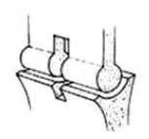
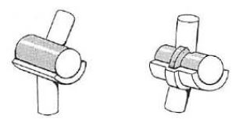
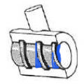
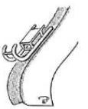
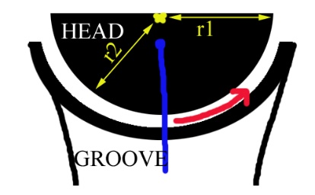
Diarthrosis [Articulationes synovialis]
Art. condylaris – condylar joint
A half cylinder in the dross direction provides the joint head
May be double
If only flexion and extension, that it may be a trochlear joint by function (art. trochlearis)
eg.: art. femorotibialis
Ginglymus
The joint head and groove are precisely fitting each other
Only flexion and extension
It must be perpendicular to the axis
Art. cubiti
May be a snap joint by function
Art. cochlearis – cochlear joint
There is an angle between the ridge and the axis of movement
Art. tarsocruralis (Eq)
May be a snap joint by function
Art. delabens –”sledge” joint
The head slides between two ridges
Art. femoropatellaris
Art. spiralis – spiral joint
The head is a flat sphere (r1>r2)
The elastic collateral ligaments originate from inside the center => slowing the movement down
Flexor part of the stifle joint (art. femorotibialis)
Is also a class by function!

Slide 11
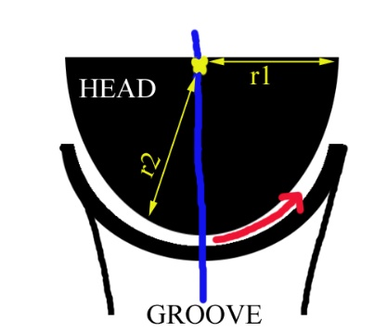
Diarthrosis [Articulationes synovialis]
[classification by function*]
…
snap joint
The joint head is an elonganeted sphere (r1<r2)
The elastic collateral ligaments originate from outside the center => sacceretaion
art. talucruralis
spirálízület
The head is a flat sphere (r1>r2)
The elastic collateral ligaments originate from inside the center => slowing the movement down
…
* Only explaing the two critical ones without details of the family

Slide 12
Myologia
Contractibility (contractilitas)
Elasticity (elasticitas)
Stimulatable (irritabilitas)
Conductivity (conductivitas)
Striated muscle
Smooth muscle
Cardiac muscle
Cytology (aktin-miozin, myofibra, myolemma, sarcolemma stb.)
Physiology (vörös izom vs fehér izom)
Meat

Slide 13
Myologia
Tendo of origin (tendo)
Head (caput)
Biceps, triceps…
Belly (venter)
Biventer
Insertion (cauda)
M. communis
Functio
Main
Auxiliary
Synergist
Antagonist
Pennate
Unipennate
bipennate/multipennate
Larger muscle power
More endurance
Smaller range

Slide 14
Myologia
Blood- and nerv supply
Fascia musculi
Bursa synovilais
Vagina tendinis
Vagina synovialis
sleeving
communis
Vagina fibrosa
fastening

