Slide 1

Welcome to UVMB
Students’ Secretariat:
Dr László REINITZ
Head of
International Secretariat
Miss Zita ARANY
Students’
Secretary for
1st and 2nd year
Mrs Mónika CSINTALANNÉ STEINER
5th year,
11th semester
Ms. Csilla MÁRFÖLDI
3rd, 4th year
Ms Dóra
KOVÁCS
German programme

Slide 2
Our website: Education> Students’ secretariat https://univet.hu/en/education/students-secretariat/
Calendar, regulations, general- and academic information, eg.
- visa information
- student card registartion
- health insurance

Slide 3

Opening hours
Building H, 1st floor
Monday 9:00 – 13:00
Wednesday 9:00 – 13:00
Thursday 9:00 - 11:00
13:00 – 15:00
arany.zita.csilla@univet.hu
Phone: (1) 478 4100 / 8322
student@univet.hu
Never email to the rector or vice rector!
The Secretariat is CLOSED during the weekend and in the evening
complaints@univet.hu

Slide 4
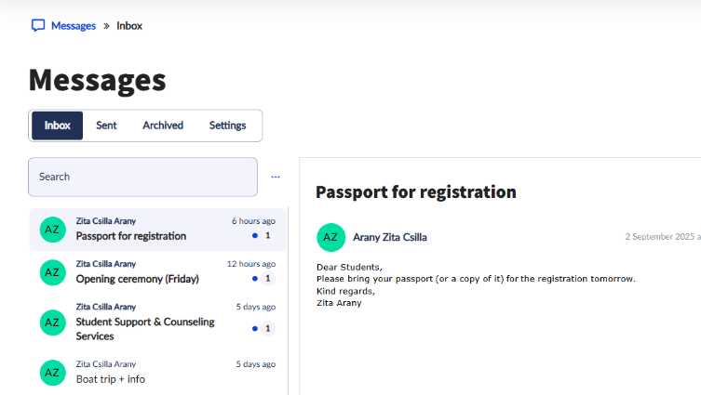
Neptun messages
Please always read the messages from your secretary
Reply via email: arany.zita.csilla@univet.hu

Slide 5
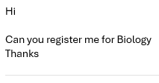
Communicating with the Secretariat Staff
Use a polite greeting
Address them by name (e.g., “Dear Zita” or „Dear Dr. Reinitz”), or use “Dear Student Secretary,”
Introduce yourself
State your full name, Neptun code, year
State your purpose clearly
Be concise about what you need (e.g., scheduling a meeting, requesting a document, clarifying information).
„Dear Zita”
I would like to register for the Biology exam on 16th December 8AM, however when I try to register, neptun says the registration period has finished.
Could you help me?
Kind regards,
Amanda Madeup BGHJJ3, year 1

Slide 6
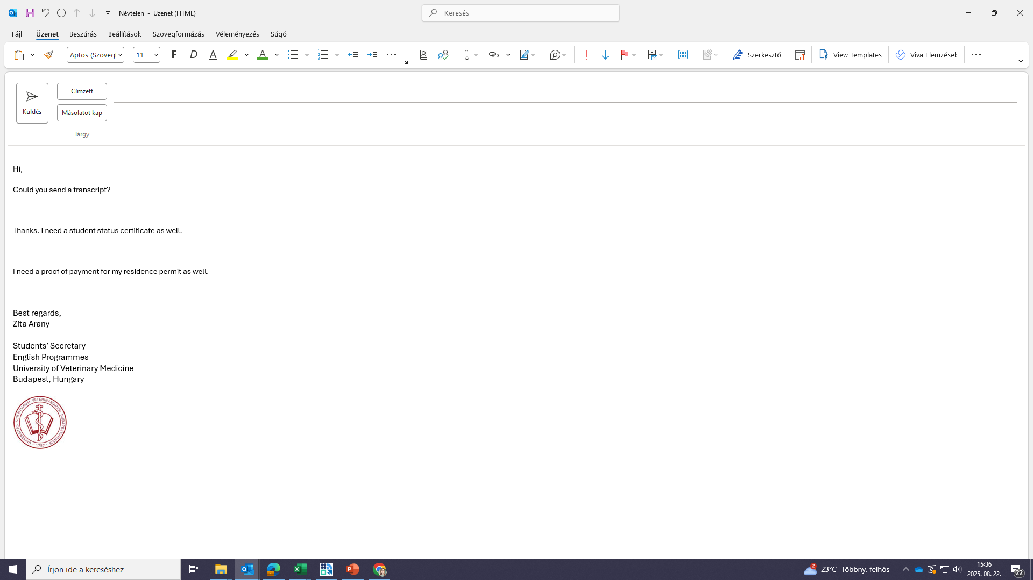
Be efficient!
Please don't send several emails about the same subject. Think through what you need and write it in one email.
This saves time for both of us.
Check:
What do you need for your residence permit application?
Dear Zita,
I’m renewing my residence permit. Could you provide
- a transcript
a student status certificate
Certificate that I have paid the tuition fee for the upcoming semester
Kind regards,
Amanda Madeup HFDZ23, 1st year

Slide 7
Student Representatives
Student representatives act as intermediaries between students and university administration. They collect feedback, concerns, and suggestions from their peers and communicate it with the Students’ Secretariat.
We are looking for 2 volunteers: if you are a good communicator and have an outgoing personality, please email your secretary.
We need 2 volunteers for the opening ceremony on Friday
  Reads the oath
  Shakes hand with the Rector

Slide 8
Anatomy & Histology Dept. - Bldg. E
(Anatomy, Histology, Biology lessons
- incl. Histology practice hall
You can find our map on : https://univet.hu/en/education/students-secretariat/downloads-forms-tutorials-faq/lecture-halls/

Slide 9
Department of Chemistry (left wing)
Department of Physiology and Biochemistry (right wing) – at Building C
(Chemistry, Biophysics, Physiology and Biochemistry lessons)
Botany and Animal Nutrition Department at Rottenbiller Street 50. (for practicals only –lectures are in István street!)
Poisonous plants elective is at Rottenbiller street, 1st floor Botany practice hall

Slide 10
Building D: Library (reading room – entrance from Rottenbiller street side)
Equus club: study room, disco on Thursdays, concerts, quizzes

Slide 11
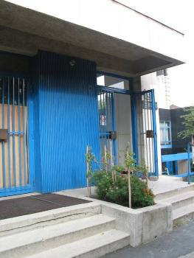
Building G: book store + gym (weight lifting room in the basement + sauna)

Slide 12
Student center – Building P.
7.30 – 21.00 (cafeteria + lounge)

Slide 13
Clinics
Small animal clinic and Exotic animal clinic are on campus
Farm animal and Equine Clinic is at Üllő (shuttle bus)
Biking: Bike-parking next to
  Bldg. C (Chemistry)
  or at the Cafeteria

Slide 14
Schedule
Opening Ceremony:
Friday, September 5, 2025, at 10:00 a.m.
Start of the Academic Year:
Monday, September 8, 2025
Enrolment in NEPTUN (for all students):
August 27 – September 12, 2025
Course Registration in NEPTUN:
From Wednesday, August 27, 2025, 8:00 a.m. to Friday, September 12, 2025, 11:00 p.m.
Teaching Period:
September 8 – December 12, 2025

Slide 15
Thursday evening
Boat-trip on River Danube
Meeting on Thursday, 4th of September, 2025, Boarding: 5:30 p.m.
Pest side, half way between Elizabeth & Chain Bridge,
Vigadó tér /Vigadó square/, ship station nr. 5, Ships name: Budapest
Departure: 6 p.m. - Arrival: 8 p.m.
Soft drinks and food are offered on the boat at the beginning of the trip which are free of charge. After that if you want more drinks and food, you can buy yourself at the buffet.
Students only - please leave friends and family at home!

Slide 16





Opening ceremony
School opening ceremony on 5th Sept.
Friday from 10.00 (elegant clothes)
Head-phones pick up from 9.30
(name of student only)
Sitting upstairs
Entrance from Bethlen Gábor street
Online streaming: https://univet.hu/en/ceremonial-opening-2025/

Slide 17
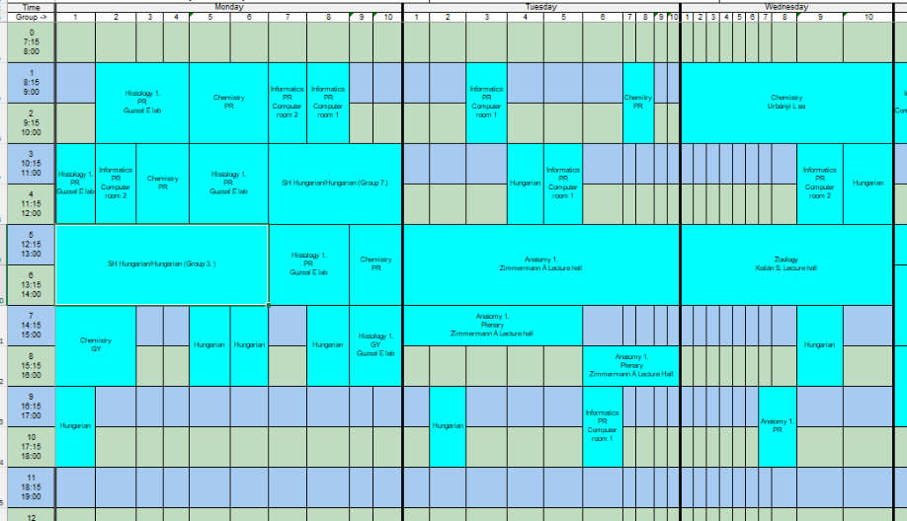
Timetable (First term 2025/26)
10 practical groups

Slide 18
Timetable – first week – Monday - Anatomy
Monday:
English extra lecture: 4-5.00 PM
English Equine plenary: 5-6.00 PM
both in the Aula Maxima, Bldg. G
1st group Hungarian lab => Friday 12.15
Later on during the week:
Tuesday: NO Anatomy lecture
Wednesday-Thursday-Friday: regular Anatomy 1 practicals (dissection) will be held in the
first week also! Building E1, groundfloor, Dissection hall
(Anatomy 3 practicals for 2 in 1 students are NOT held during the 1st week)
Anatomy: exam on the dissection room and exam regulations
(material available in moodle) will be required!
Deadline: 09th September 8:00

Slide 19
Timetable - Monday
Anatomy Lecture
Assembly Hall
16.00--17.00 by László Reinitz
Horse demonstartion
Assembly Hall
17.00-18.00 by Mátyás Kapiller

Slide 20
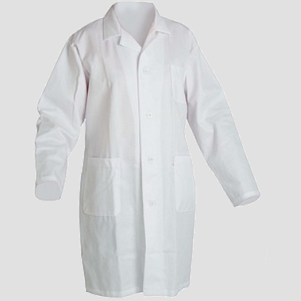
Lab-coats for Anatomy and Chemistry https://mediwears.hu/en/ https://www.samtex.hu/index.php/en/
Student Council: ate.hok@gmail.com
Long coat: up to knees
Arms are covered
Must be white

Slide 21
Library introduction
Next week (8th-12th of September)
Building D, at the Library entrance
Group #1 - Friday - 12:15
Group #2 - Friday - 12:40
Group #3 - Friday - 10:40
Group #4 - Wednesday - 10:15
Group #5 - Wednesday - 10:40
Group #6 - Wednesday - 11:15
Group #7 - Wednesday - 11:40
Group #8 - Tuesday - 10:40
Group #9 - Tuesday - 14:15
Group #10 - Tuesday - 14:40

Slide 22
Residence permit
Information on the website: https://univet.hu/en/education/students-secretariat/first-steps-of-our-freshmen/residence-permit-information/
30/60 days to arrange (non-EU/EU)
What you need to submit: school enrollment certificate, lease contract, passport copy, health insurance, bank statement, photo (non-EU)
Immigration Office website:
https://enterhungary.gov.hu/eh/?en
Online application
Requirements may vary from country to country
Address: 1135 Bp. Szegedi út 35-37.
Email: bp2@oif.gov.hu
Phone: +361 5501165

Slide 23
Student card
Information on our website:
https://univet.hu/en/student-support-services-at-univet-budapest/admin-help-for-freshers/permanent-student-card/
The student card certifies your student status. Entitles you to discounts on public transportation tickets, entrance fees (library,museums, cinemas etc.), restaurants among others.
In order to receive the plastic card, you are requested to follow these steps:
1 - Go to a Registration Office (in Hungarian: Okmányiroda/Kormányablak) and apply for a student card;
2 – Bring your passport/ID-card + residence permit (bear in mind you should already have one before applying) with you for the application;
(Take a number for „Diákigazolvány"=student card and wait to be called)
3 – Once there ask for „Diákigazolvány ügyintézés (Student card management) and they will give you a „NEK-adatlap (NEK-sheet)
Fill out the sheet. Please note that all information must match the info in Neptun (address, mother’s name etc..);
4 – Hand in the NEK-sheet at the Student Secretariat’s Office
It can take weeks, months for the plastic card to arrive.
6 – In the meantime apply for a temporary card untill the official card arrives (Please note – You can only apply for a temporary card once you already applied for the official card)
The temporary card is valid for 2 months;
7 – Once the official plastic card arrives you will get an e-mail from us to pick it up (only valid with a sticker, ask from the Secretary);
1st semester stickers are valid until the end of March, 2nd semester stickers are valid until the end of October.

Slide 24
Student card registration offices:
(‘okmányiroda’)
Some examples of the closest offices:
VIII. District reg.office: 1087 Budapest, Kerepesi út 2-6. (Keleti Train Station)
VII. district reg.office: 1073 Budapest, Erzsébet körút 6. fszt.
VI. district reg.office: 1062 Budapest, Andrássy út 55.
V. district reg.office: 1051 Budapest, Erzsébet tér 3.
Central Registration Office: 1133 Budapest, Visegrádi utca 110. (open: weekdays: 8.00 – 20.00, weekends: 8.00 – 14.00)
For more info on opening hours, please check: https://kormanyablak.hu/hu/kormanyablakok/budapest/1

Slide 25
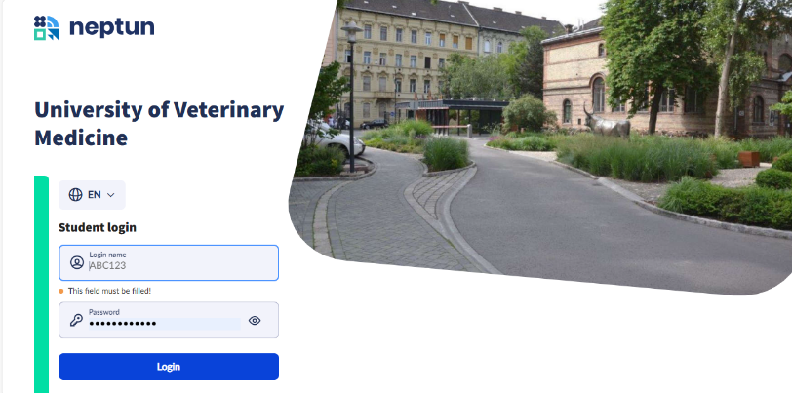
NEPTUN unified education system: neptun.univet.hu
Neptun.Support@univet.hu

Slide 26
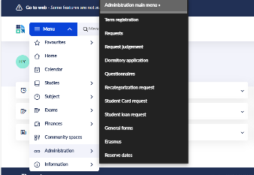
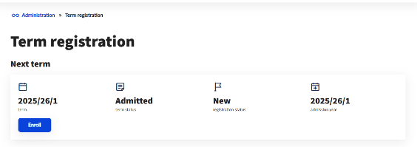
Registering to the term
Menu > Administration> Term registration
Click on the Enroll button
Fill out the form

Slide 27
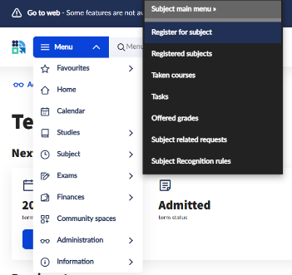
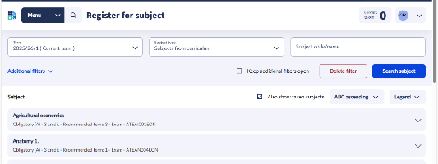
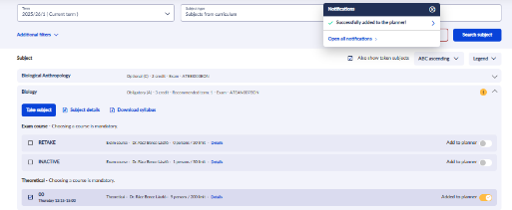
Registering to subjects (until 12th of September)
Menu > Subject (Object) >Register for subject
Make sure you are on the current term 2025/26/1

Slide 28
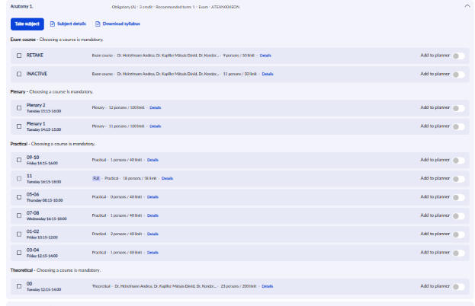
Anatomy
You need to register for the Anatomy 1 practical exam first
Then you can Register to Anatomy 1: select Plenary, Practical (group) and Theoretical 00 course
Anatomy 1:
ATEAN004EON - theory: 00 course - practical: 01-10 (according to which group you are in) - plenary 1 (if you are in group 1-5) and plenary 2 (if you are in group 6-10)
Anatomy 1 practical exam course: 00 code

Slide 29
Chemistry: ATEKE003EON - theory: 00 course - practical: 01-10 (according to which group you are in)
Histology 1: ATEAN002EON - theory: 00 course; - practical: 01-10 (according to which group you are in, two or three groups are together)
Biology ATEAN007EON - theory: 00 course (no practical course
Biophysics: ATEKE002EON - theory: 00 course (no practical course) Informatics: ATEBM002EON - theory: 00 course - practical: 01-10 (according to which group you are in)
Informatics: ATEBM002EON - theory: 00 course - practical: 01-10 (according to which group you are in)
Zoology: ATEPA001EON - theory: 00 course (no practical course)
Basics of Hungarian Veterinary Communication 1: ATEIL024EON - practical: 01-10 (according to which group you are in)
( + if you are a Stipendium/Diaspora scholarship holder: ATEIL008EON SH Hungarian A1/1.)

Slide 30
Thank you for your attention!

