Slide 1
HUMÁN ANATÓMIA VIZSGAANYAG 2017

Slide 2
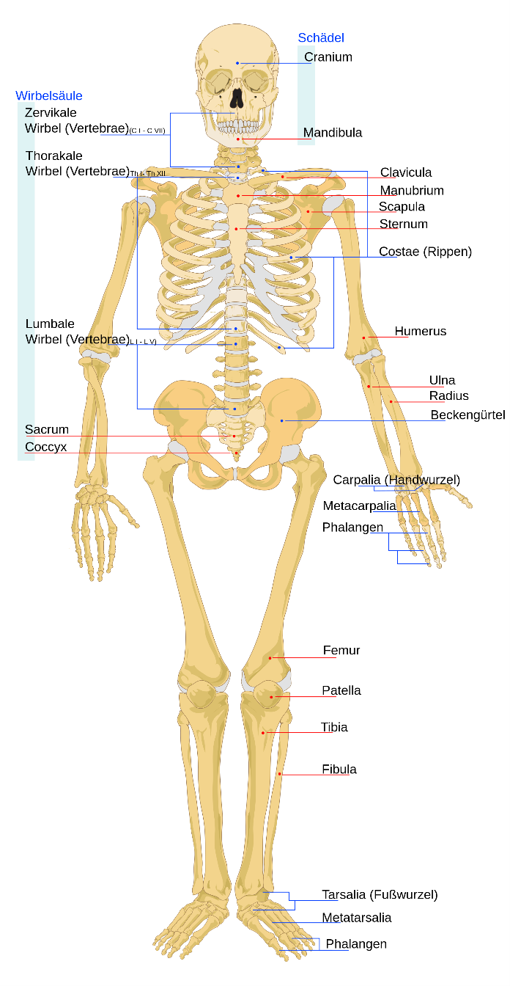
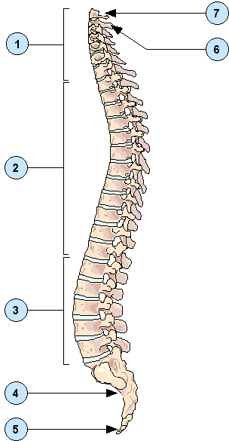
Atlas
Vertebrae
cervicales
Axis
Vertebrae
thoracales
Vertebrae
lumbales
Sacrum
Os coccygis

Slide 3
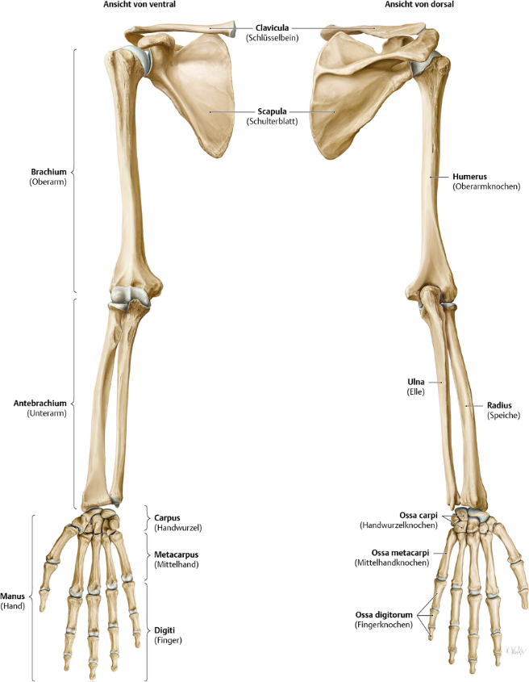

Slide 4
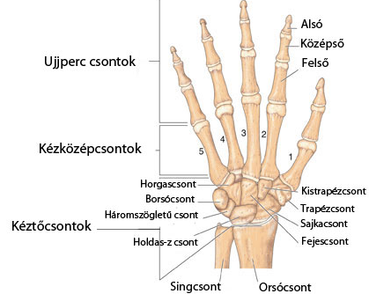
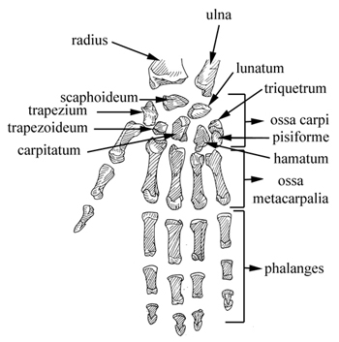

Slide 5
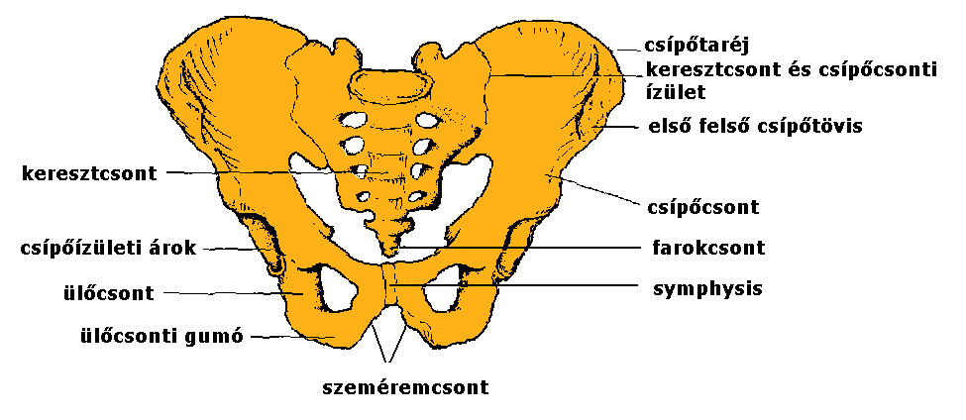
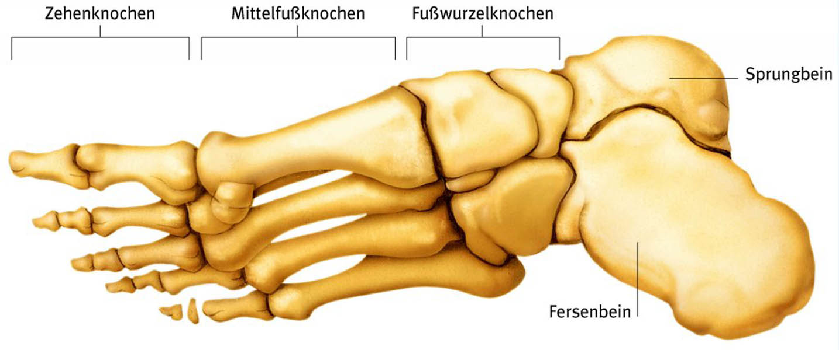
Crista iliaca
Articulatio sacroiliaca
Spina iliaca anterior superior
Sacrum
Os ilii
Acetabulum
Os coccygis
Os ischii
Tuber ischii
Os pubis
metatrsus
tarsus
phalanges
talus
calcaneus

Slide 6
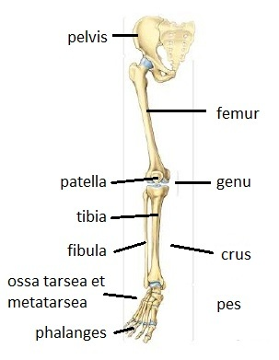

Slide 7
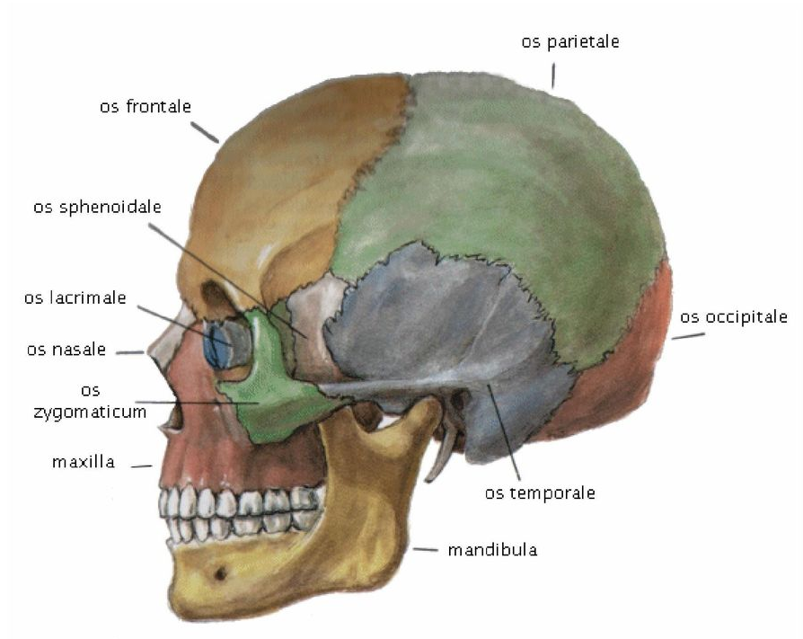
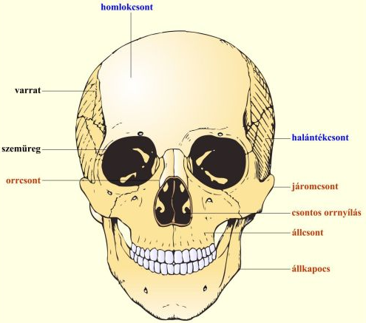
Os frontale
Sutura
Orbita
Os temporale
Os nasale
Os zygomaticum
Apertura piriformis
Maxilla
Mandibula

Slide 8
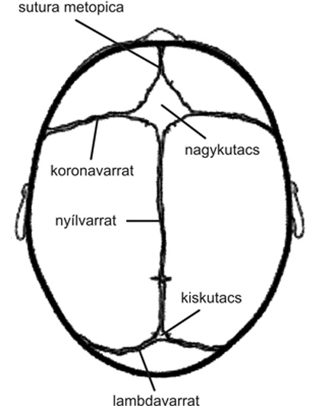

Slide 9
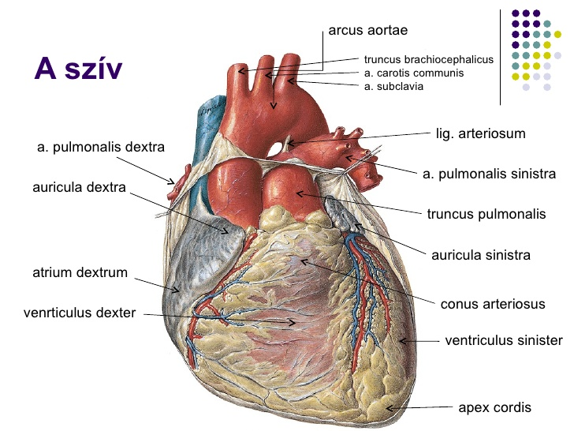
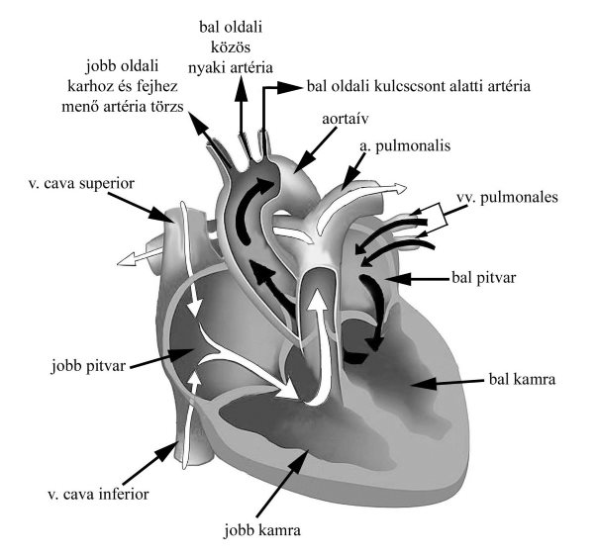

Slide 10
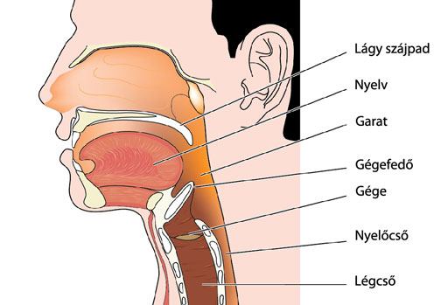
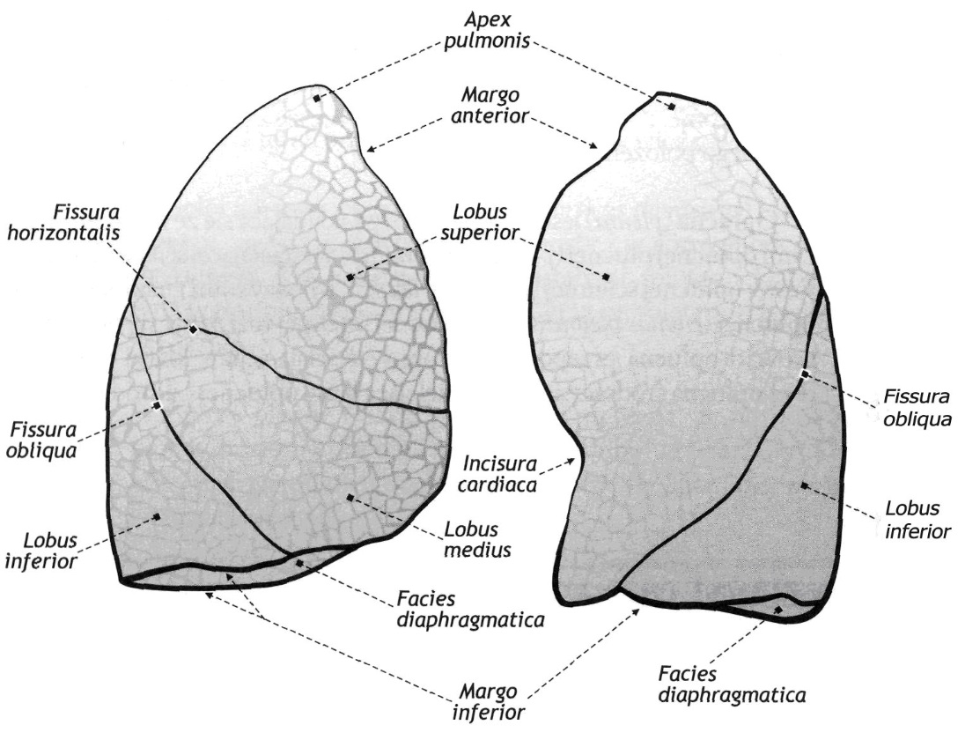
Palatum molle
Lingua
Pharynx
Epiglottis
Larynx
Oesophagus
Trachea

Slide 11
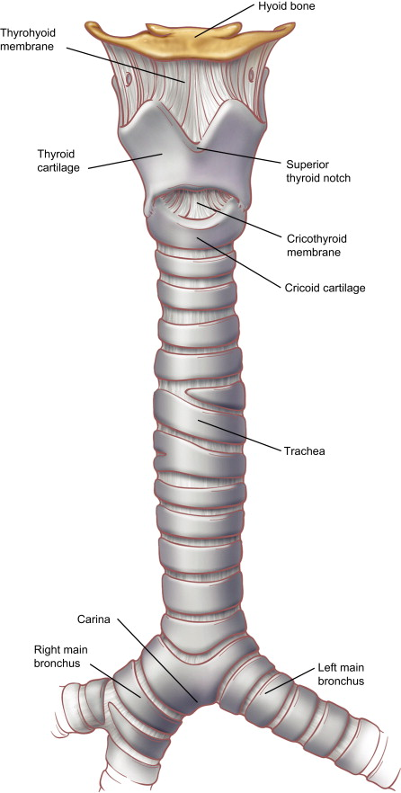
Os hyoideum
Membrana
thyrohyoidea
Incisura
thyroidea
superior
Cartilago
thyroidea
Ligamentum
cricothyroideum
Cartilago
cricoidea
Trachea
Bronchus principalis sin.
Carina
Bronchus principalis dext.

Slide 12
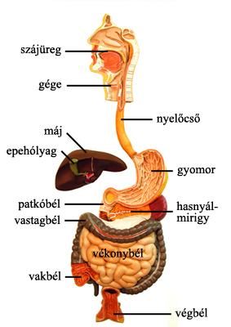
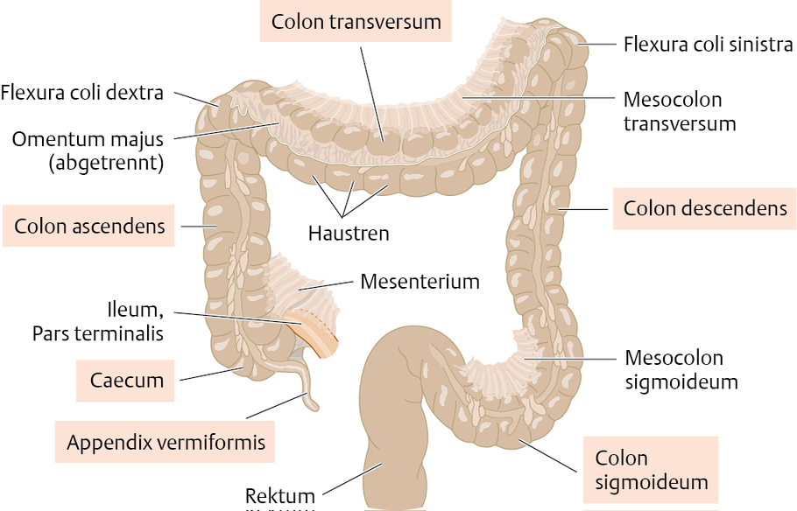
Cavum oris
Larynx
Hepar
Oesophagus
Vesica fellea
Gaster
Duodenum
Pancreas
Colon
transversum
Cecum
Rectum

Slide 13
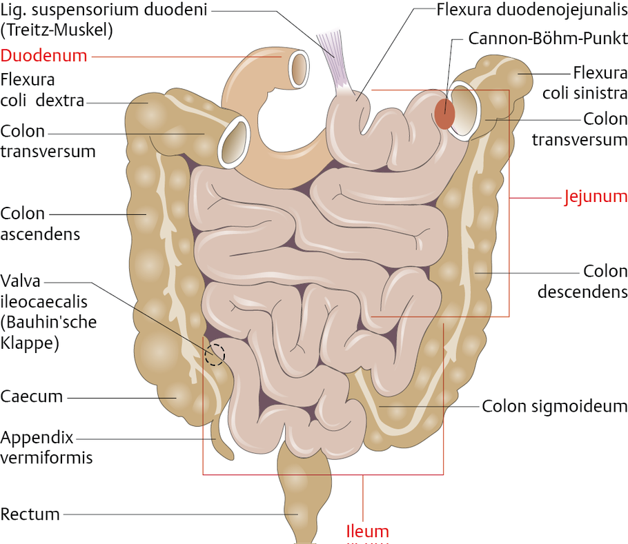

Slide 14
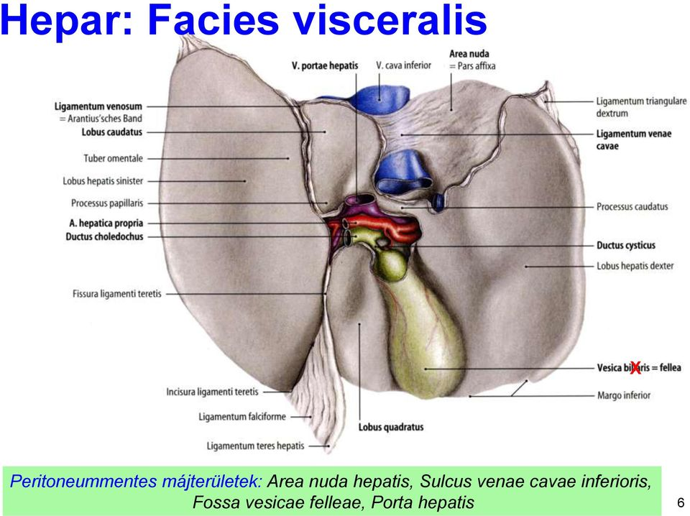
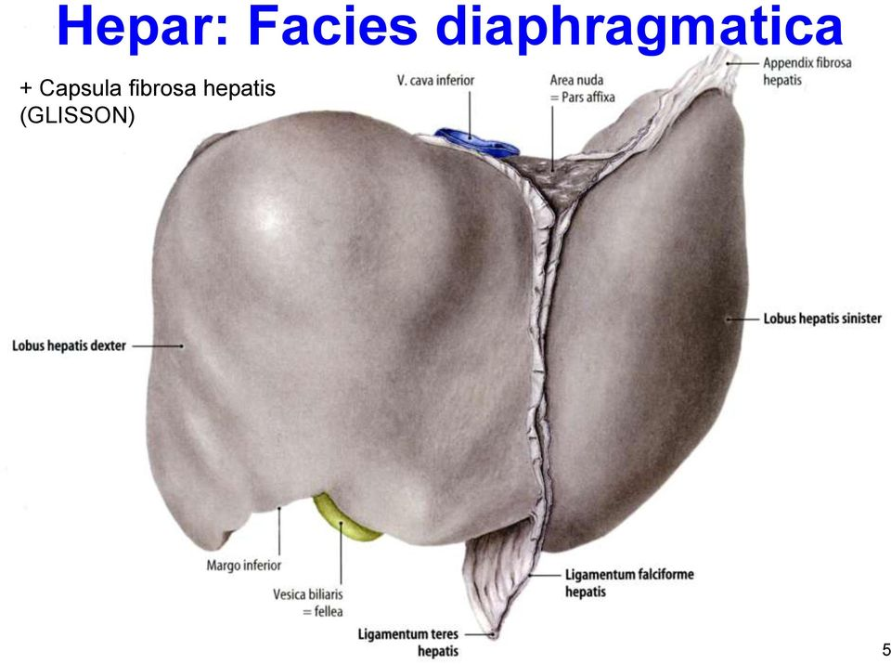

Slide 15
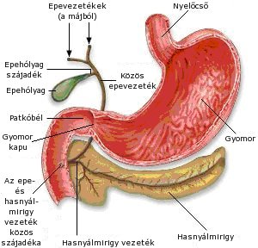
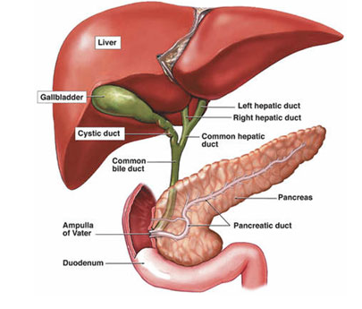
Hepar
Vesica felleae
Ductus hepaticus sin.
Ductus hepaticus dext.
Ductus cyticus
Ductus
hepaticus
comm.
Ductus
choledochus
Vater papilla
Ductus pancreaticus
major

Slide 16
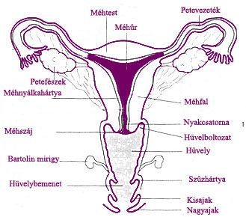
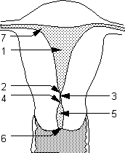
1. Cavum uteri,
2. Ostium uteri internum anatomicum,
3. Canalis isthmi,
4. Ostium uteri internum histologicum,
5. Canalis cervicis uteri,
6. Ostium uteri externum,
7. Ostium uterinum tubae uterinae.

Slide 17
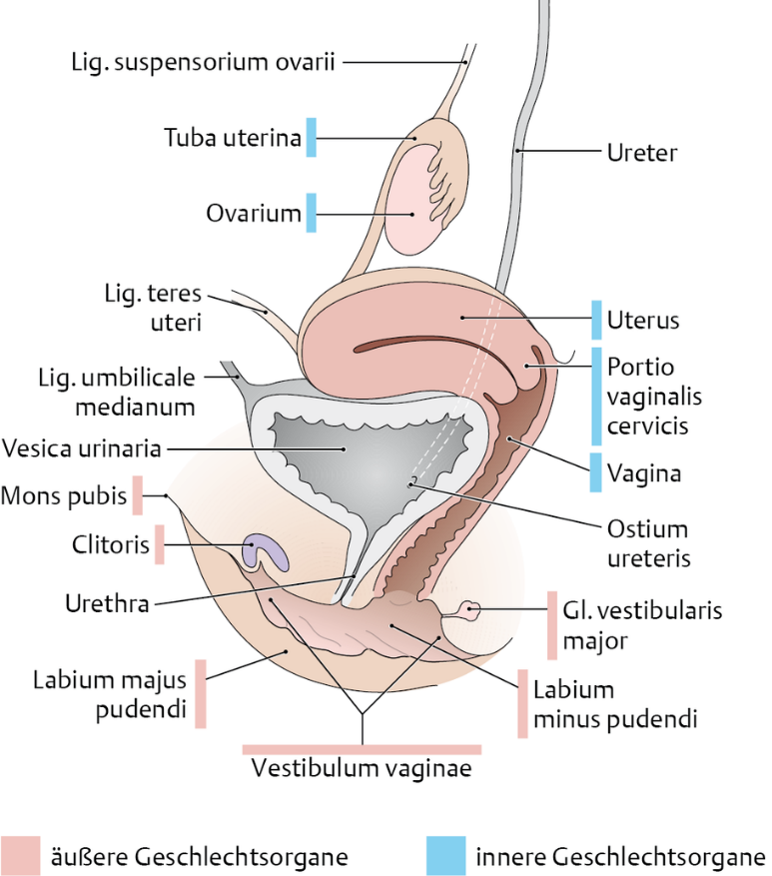
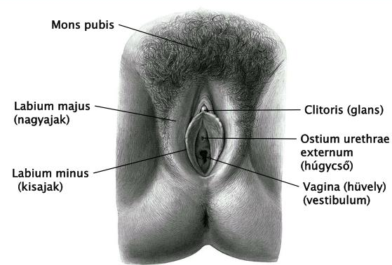

Slide 18
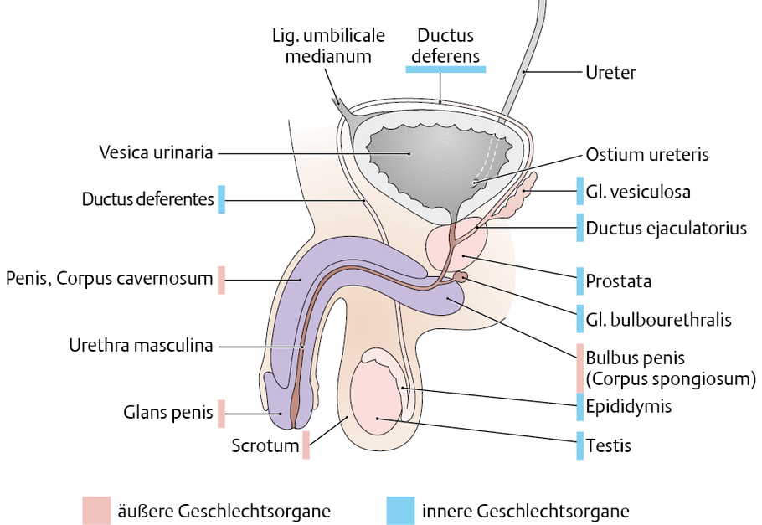
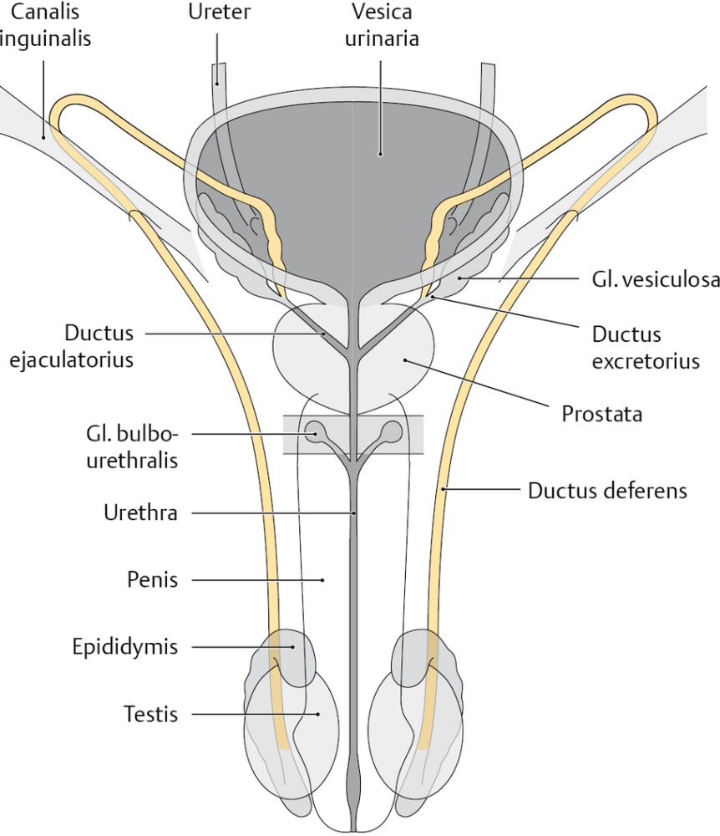

Slide 19
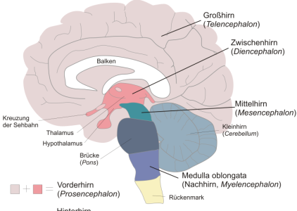
corpus callosum
cerebrum
köztiagy
középagy
chiasma
opticum
kisagy
cerebellum
híd
pons
medulla spinalis

Slide 20
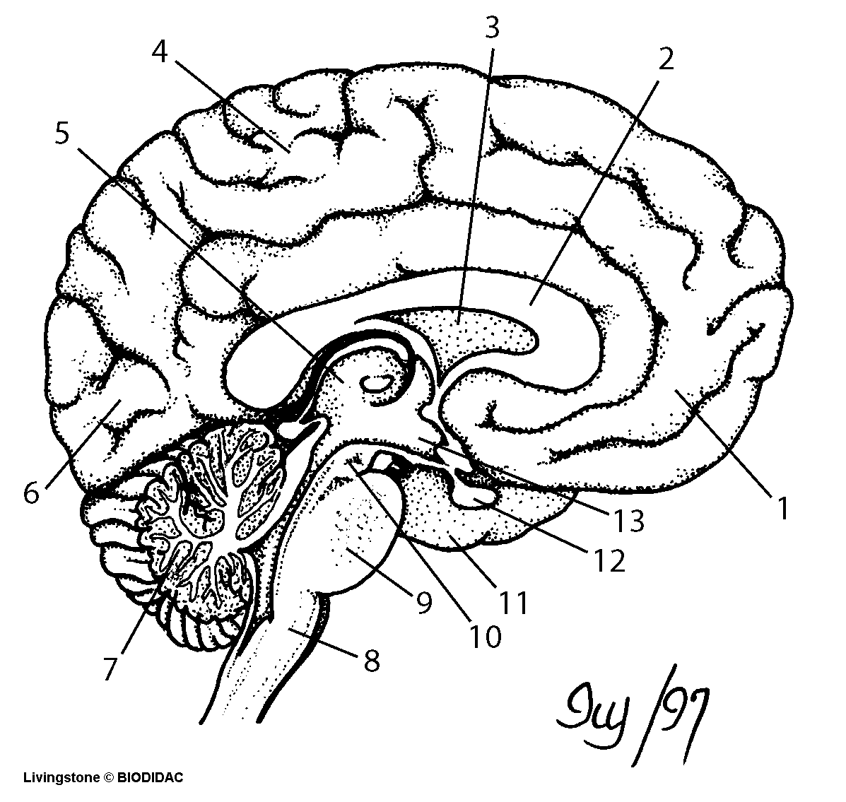
1=lobus frontalis, 2=corpus callosum, 3=ventriculus 4= lobus parietalis,
5=thalamus, 6=lobus occipitalis , 7=cerebellum, 8=medulla oblongata,
9=pons, 10=mesencephalon, 11= lobus temporalis, 12 hypophysis,
13=hypothalamus

Slide 21
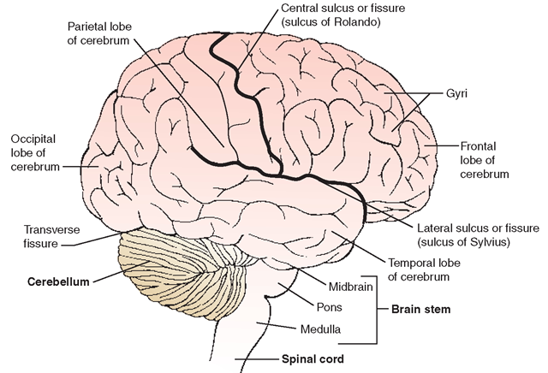
Gyrus postcentralis
Gyrus praecentralis
Lobus
parietalis
Sulcus centralis
Lobus
occipitalis
Lobus
frontalis
Fissua transversa
Sulcus lateralis
Lobus temporalis
Mesencephalon
Agytörzs
Medulla spinalis

