Slide 1
Use-case: food safety and risk assessment research – the EU scope
Digital Food institute
Digital Food Institute
University of Veterinary Medicine
Budapest

Slide 2

Why do we die?
Digital Food institute
food safety risk assessment
Heart diseases and cancer account for 75% of causes of death in Hungary
This is 100.000 people annually
Most obese country in Europe, 4th most obese in the world
30% of adults obese, another 30% is overweight
With better screening programs, diagnostics and lifestyle 30.000 deaths could be avoided annually
40% of disease burden is attributed to environmental exposure and lifestyle

Slide 3
The food safety risk analysis framework
Digital Food institute

Slide 4
Risk analysis
Digital Food institute
Risk analysis framework

Slide 5
Risk assessment
Digital Food institute
Risk analysis framework
Hazard identification
Identify the effects that are considered as adverse
Hazard characterisation
Quantification of the adverse effects.
Risk characterisation
Integrates information from exposure assessment and hazard characterisation into advice suitable for use in decision-making.
Exposure assessment
Qualitative and/or quantitative evaluation of the likely intake of biological, chemical or physical agents via food

Slide 6
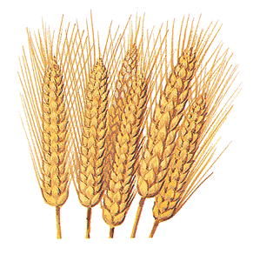
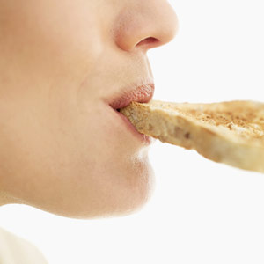

Exposure assessment
Digital Food institute
Risk analysis framework
Food
Terminology
Chemical Occurrence
Food consumption
Exposure Assessment

Slide 7
Data for food safety risk assessment
Digital Food institute

Slide 8
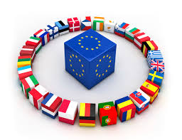


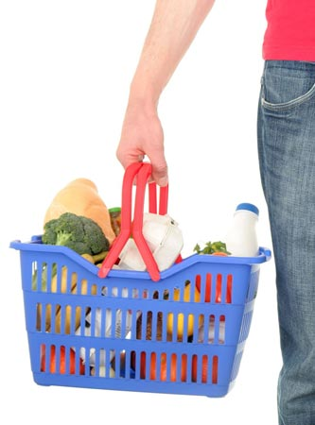

Data providers
Digital Food institute
Data for food safety risk assessment
Member State authorities
European Commission
Industry
Consumers
associations
University, academia, etc.

Slide 9

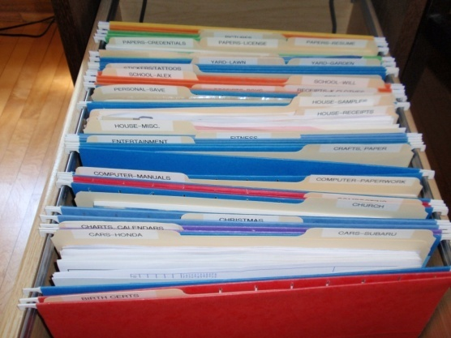
Standardisation
Digital Food institute
Data for food safety risk assessment
Standardisation and harmonization
Coordinated approaches
Standard protocols
Compatible systems

Slide 10
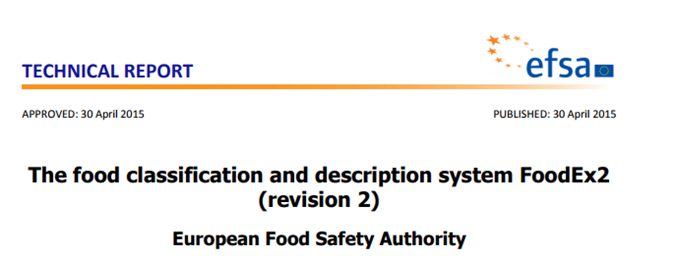
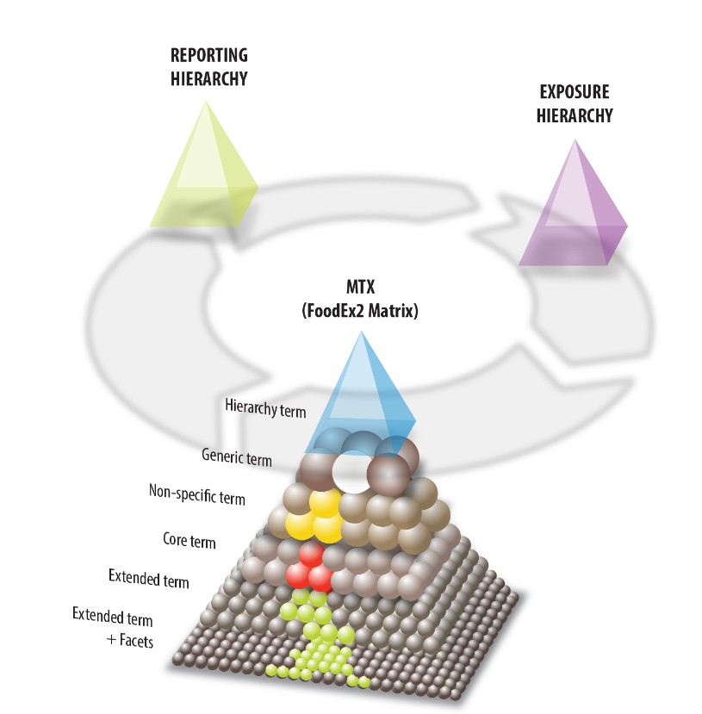


FoodEx2
Digital Food institute
Data for food safety risk assessment
FoodEx2 is a comprehensive food classification and description system aimed at covering the need to describe food in data collections across different food safety domains.

Slide 11
SSd2
Digital Food institute
Data for food safety risk assessment
Standard Sample Description
Logical data model, designed to support denormalised data transmission
Support the data collection and transmission of the samples data and the results of analytical measurement of several data collections domains
Designed for data storage (relational database) and analysis
>70 data fields
  food classification
  parameters
  measurement methods
  …

Slide 12
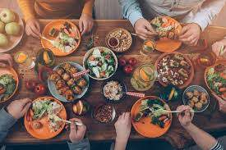
food consumption database
Digital Food institute
Data for food safety risk assessment
The EFSA Comprehensive European Food Consumption Database contains data:
  24-hour recall or dietary record method
  data collected at individual level
  most recent data within each country
  random sample at national level
    different age classes, from infants to elderly
    special population groups
http://www.efsa.europa.eu/en/food-consumption/comprehensive-database

Slide 13
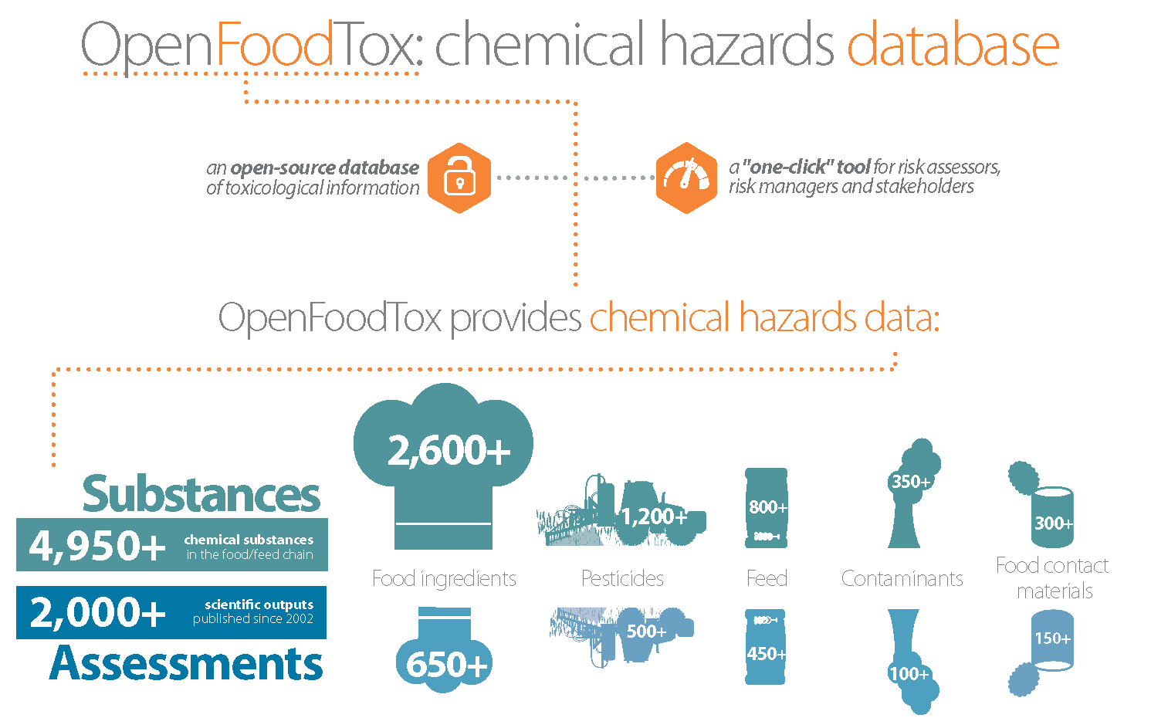
OpenFoodTox
Digital Food institute
Data for food safety risk assessment
http://www.efsa.europa.eu/en/data/chemical-hazards-data

Slide 14
Challenges and opportunities
Digital Food institute

Slide 15






What we haVE
Digital Food institute
15
Challenges and opportunities
THE GOOD
AND THE BAD
Existing ontologies/classifications to build on:
  Standard Sample Description
  Food classification system
EU-wide detailed data on:
  food consumption
  food contaminants (and some nutrients)
Ontologies/classifications:
  Still have to be adjusted to research needs
  Sometimes hard to implement
Still very few data on nutrients/compounds
Little knowledge on real consumption patterns
Very little knowledge on combined exposure and on the combined effect
  Still ‘one chemical at a time’ assessment

Slide 16
What we can achieve
Digital Food institute
16
Challenges and opportunities
Better understanding of combined exposure to contaminants and nutrients
Better risk assessment
Better benefit assessment
Better insight on food chain processes
(how nutrients and contaminats change over time due to processing)
New way of thinking about:
  risks vs benefits
  combined exposure
  multi-criteria decisions
  personalized diagnostics /
  medicine / nutrition
→ Better food safety and nutrition policies

Slide 17
Thanks for your attention
Digital Food institute
DIGITAL FOOD
INSTITUTE
01100110
01101111
01101111
01100100
Miklós Süth, DVM PhD, Director of DFI
Ákos Józwiak, DVM PhD, Research Director of DFI
Szilveszter Csorba, MSc, DFI
Tekla Engelhardt, PhD, DFI
Zsuzsa Farkas, PhD, DFI
Erika Országh MSc, DFI
Kata Kerekes MSc, NÉBIH

