Slide 1
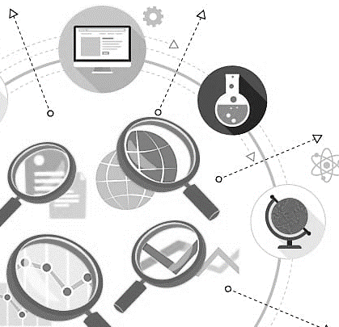
MilkyBase
A Big Data strategy
Mayara Lopes Martins, M.Sc. - Ph.D. Student
Tünde Pacza, M.Sc. - Ph.D. Student
József Baranyi, Ph.D. - Supervisor

Slide 2
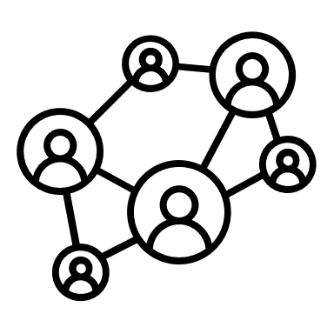
To create a systematic database on the biochemical components of the human milk
Objective
MilkyBase
Team
HooDome
Barabási Lab

Slide 3
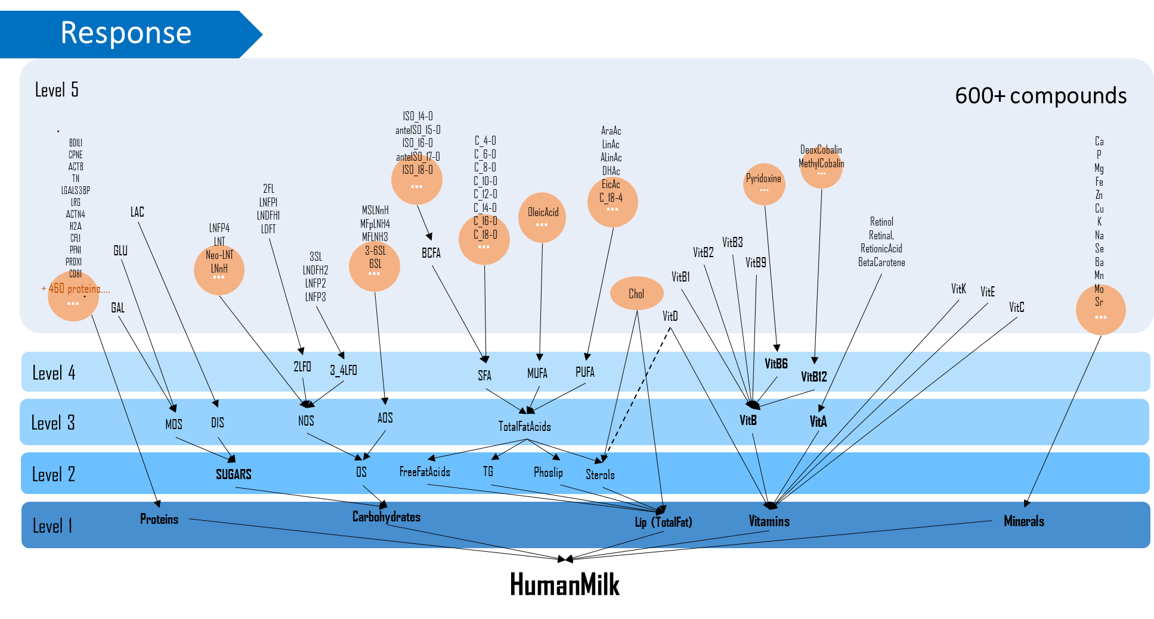
Timeline
1st
9 February
2020
People responsible for inputting data
Studies info (DOI, year, responsible)
Main sheet
(MilkyBase Core)
Description and classification of inputted locations
Description and classification of methods used to meausure components
Description of various info of mothers, infants and milk samples
Description and group classification of all components
Dynamic values in the database (components, conditions)
Description of all units used in the components

Slide 4
Timeline
1st
9 February
2020
15 August
2020
Collecting Data
Inputting Data
Correcting entries
Meetings
HooDome Project - UniDeb
Milch Project – Barabási Lab
New versions
Updating MilkyBase

Slide 5
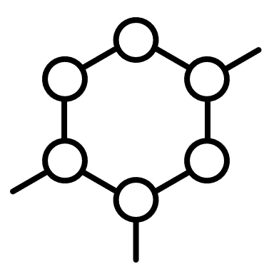
Workflow
Timeline
1st
9 February
2020
15 August
2020
Updating MilkyBase
Search for data
Publication analysis
Component identification
Feeding MilkyBase
National databases
Published studies
+300 sources
Useful data
165 sources
Search
In PubChem

Slide 6
Workflow
Timeline
1st
9 February
2020
15 August
2020
September
2020
Major problems:
Duplicated components (VitaminC; AscorbicAcid)
Incorrect group classification of components (Hormone; SignalProt)
Diversity of units (mg/L, mmol/dL, etc)
Missing connections to the Master sheet
Main activities
Corrections of Components/Grouping
Unit unification (38 units → 18 units)
Correcting missing connections to the Master sheet

Slide 7
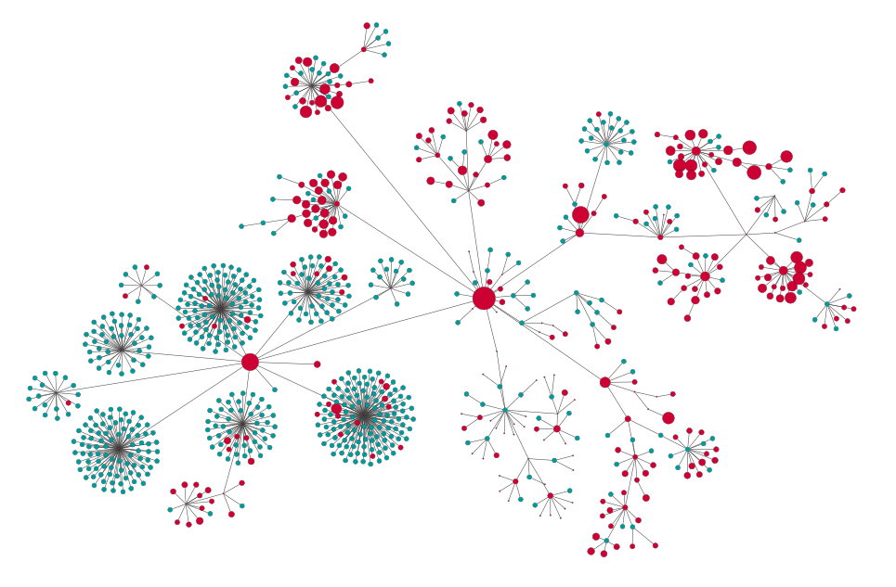
Current
Protein
September
2020
Vit
HM
Lipid
Papers: 165
Component: 863 different
Master sheet records: 1 895
Dynamic data points: 5 550
Inputted data points: 13 434
Measurements: 1 318 767
(*cohort size)
Karotenoid
CH
HM Component tree
Notes:
Where are we now?
863 component – 617 just 1 source (blue ), 177 less then 10 source

Slide 8
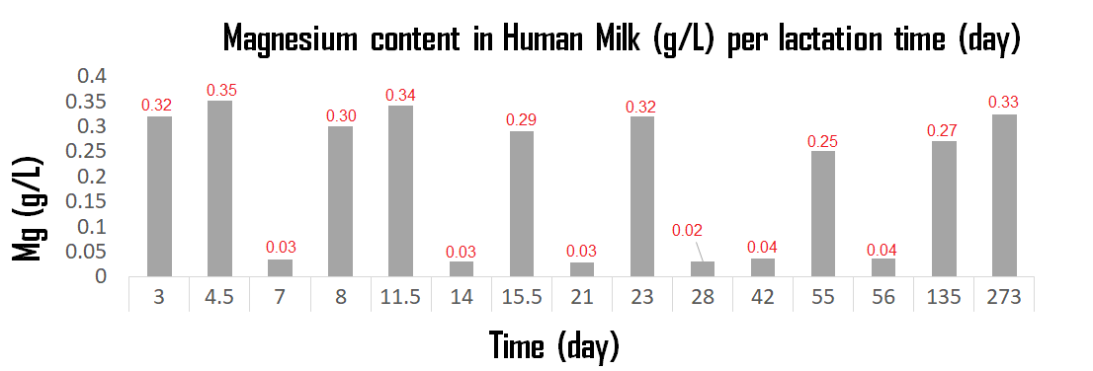
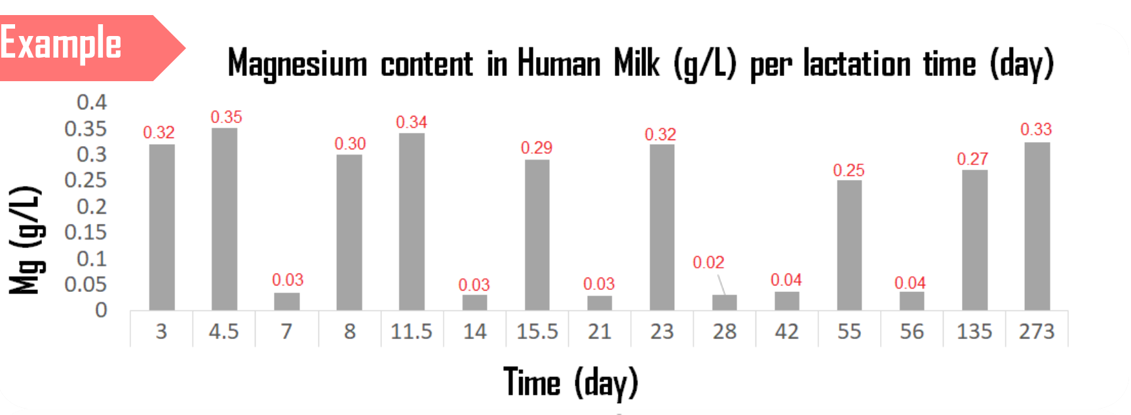
Dynamic components
Current
Corrections
DynVal sheet
Unit sheet
Agenda
Continue to update
New entries
15 August
October 2020
December 2020
Corrections
Set focus on components
Find patterns, describing statistically

Slide 9
Köszönöm!
Thank you!

