Slide 1
Hoodome: the Hungarian division of the Foodome initiative
A science-, data- and application- focussed rationale
József Baranyi, supervisor, UniDeb
Mayara Lopes Martins, PhD student, UniDeb
Tünde Pacza, PhD student, UniDeb
Anna Jánosity, PhD student, SZIE
Maha Rockaya, Tishreen University, Syria
Gyöngyi Kirschner, PhD, Consultant
Dr Katalin Müller, MD, PhD, Consultant

Slide 2
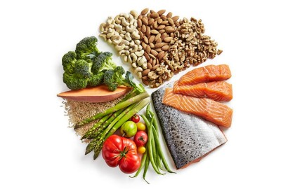
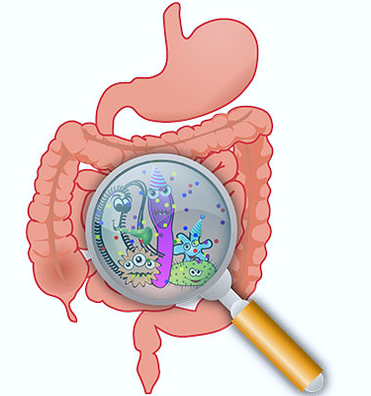
Dynamic interactions
GENE EXPRESSION
GENOME
Health
ENVIRONMENTAL
EXPOSURE
FOODOME
MICROBIOME
Genome and Food composition shape the microbiota ➔ impact on Health

Slide 3
Data base – Knowledge base
Activity
Decisions on the database
- Digitalisation, automation
- Inputting data
Measurements, publications
- Systematic data
- Data gaps, input-efficiency
- Data checking
(syntax, semantics)
- Cleaning
Spreadsheets, connected tables
- Ontology, size,
- Database resolution subject to purpose
- Browsing in data,
- Visualisation, statistics, patterns;
- Modelling, predictions
- Decisions for actions
- Optimisation
- Big capacity, fast data retrieve
- Compatibility and interactions with other databases
Data base
Availability, Accessability

Slide 4
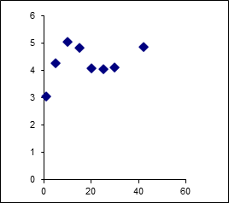
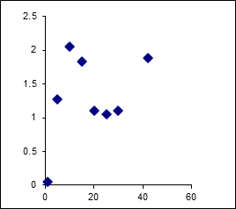
Master sheets' fields connected to definition-tables
Fields
Records
Condition
Response: food composition
ValueSet: numbers, intervals, or dynamic (time-dependent) tables
X(t) ➔ Y(t) mapping

